Slide 1
MPMCI Online Class
On 15-4-2020
to IV Sem CSE-A
B.Syamala
Asst.Professor
CSE,VCE

Slide 2
I/O Mapped and Memory Mapped I/O
There are two methods for interfacing I/O devices with the 8086
I/O Mapped I/O
Memory Mapped I/O
In I/O Mapped I/O scheme, the IN and OUT instructions are used to transfer data between the MP and the I/O devices. It is also called isolated I/O scheme.
A disadvantage of this method is that the data is transferred b/w the 8086 and
the I/O devices only by the IN and OUT instructions.
In Memory Mapped I/O, any instruction that references the memory can be used to transfer data.
The main advantage of this scheme is that there are many memory transfer
instructions in the 8086 and all of them can be used to access the I/O devices

Slide 3
Interrupts
An interrupt is an event which informs the CPU that its service (action) is needed.
Sources of interrupts:
internal fault (e.g.. divide by zero, overflow)
Software Interrupts
external hardware : maskable, nonmaskable
Reset
When an interrupt is executed, the microprocessor:
finishes executing its current instruction (if any).
saves (PUSH) the flag register, IP and CS register in the stack.
goes to a fixed memory location.
reads the address of the associated ISR.
Jumps to that address and executes the ISR.
gets (POP) the flag register, CS:IP register from the stack.
continues executing the previous job (if any).

Slide 4
Interrupt Pins
INTR: Interrupt Request.
Input signal into the CPU
If it is activated, the CPU will finish the current instruction and respond with the interrupt acknowledge operation
Can be masked (ignored) thru instructions CLI and STI
NMI: Non Mask able interrupt.
Input signal
Cannot be masked or unmasked thru CLI and STI
Examples of use: Power failure, Memory error
INTA: Interrupt Acknowledge.
Output signal

Slide 5
Programmable Interrupt Controller(PIC) Intel 8259
The intel 8259 is a single chip PIC. It is compatible with 8086,8088,8085 MP.
It is a 28 pin DIP. I.C package and uses N-MOS technology.
It requires +5V power supply to operate.
The PIC is used when several I/O devices transfer data using interrupt signal.
I/O devices are connected to the PIC. The priority can be assigned to the I/O devices.
8 I/O devices can be connected to 8259 through IR0-IR7 lines.
The interrupt controller functions as overall manager in an interrupt driven system.
One or more I/O devices can send interrupt request to the interrupt controller at the same time through IR0-IR7 lines.
The interrupt controller determines the priority of interrupts. It first entertains the I/O device of higher priority.

Slide 6
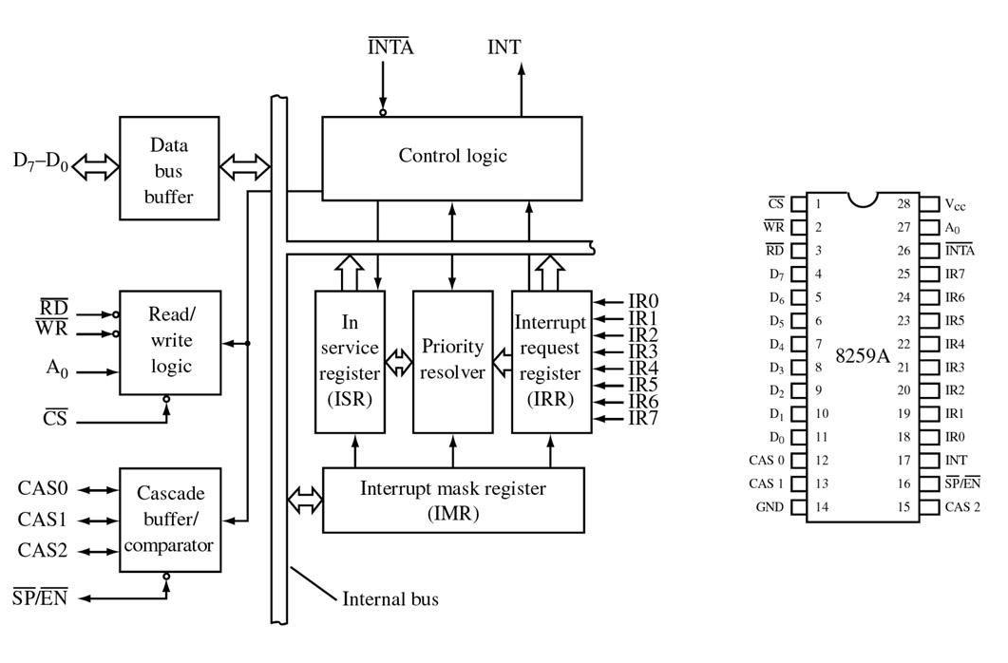
Block Diagram and Pin Diagram of 8259(PIC)
8259(PIC)

Slide 7
Operation
The 8259 sends an interrupt request to the MP through INT line.
The MP sends an acknowledgement through the INTA bar line.
The 8259 will send the address of the ISR for the concerned I/O device which is to be served.
If more than 8 I/O devices to transfer data, two 8259 ICS can be connected in series. such a connection is called cascading.
Up to 64 I/O devices can be connected employing two 8259 ICS.
When more than one 8259 are employed in a system, the 8259 which is connected to the processor is called Master. the 8259 which is connected to the master 8259 is called Slave.
The SP/EN low activated signal is used to distinguish master and slave controller.
SP/EN=1 for Master , SP/EN=0 for slave.
CAS0-2 inputs/outputs are used when more than one PIC to cascaded.

Slide 8
Internal Registers of 8259
Interrupt Request Register(IRR)
It stores the interrupt requests
It keeps information about the interrupt inputs which have requested for interrupt service
When an interrupt request is received, the IRR bit is set.
In-Service Register(ISR)
Which interrupt is currently being serviced, this information is stored in the ISR. The priority resolver determines the priority of the bits set in the IRR.
The bit corresponding to the interrupt of the highest priority is selected.
On the receipt of INTA bar signal from the CPU, the highest priority
ISR bit is set and the corresponding IRR bit is Reset.

Slide 9
Internal Registers of 8259
Interrupt Mask Register(IMR)
It controls a specific bit for each interrupt line
It is used to mask(disable) or unmask(enable) individual interrupt i/p
An interrupt i/p can be masked by setting the corresponding bit to 1 in IMR.

Slide 10
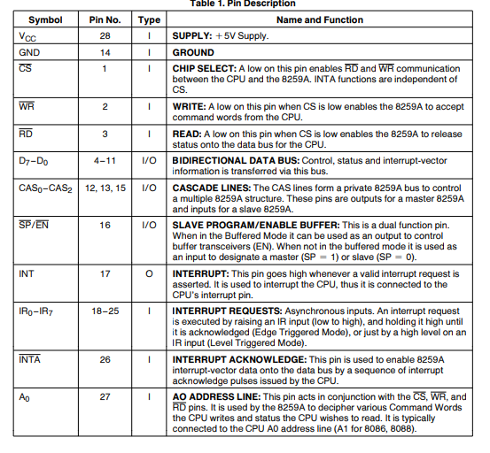
Pin Description

Slide 11
Thank you

